Slide 1
Accelerating Progress: mathematics Challenge walk-through 4B1
Gardens
Design a garden between 80m² and 120m²
Produce and accurate scale drawing
Calculate the cost of your design

Slide 2
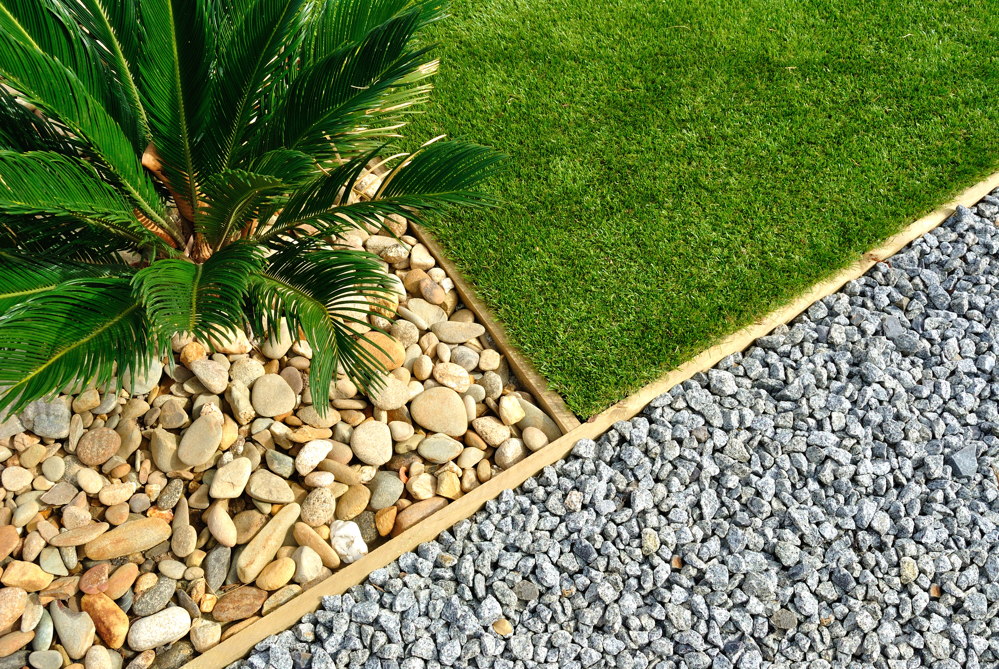
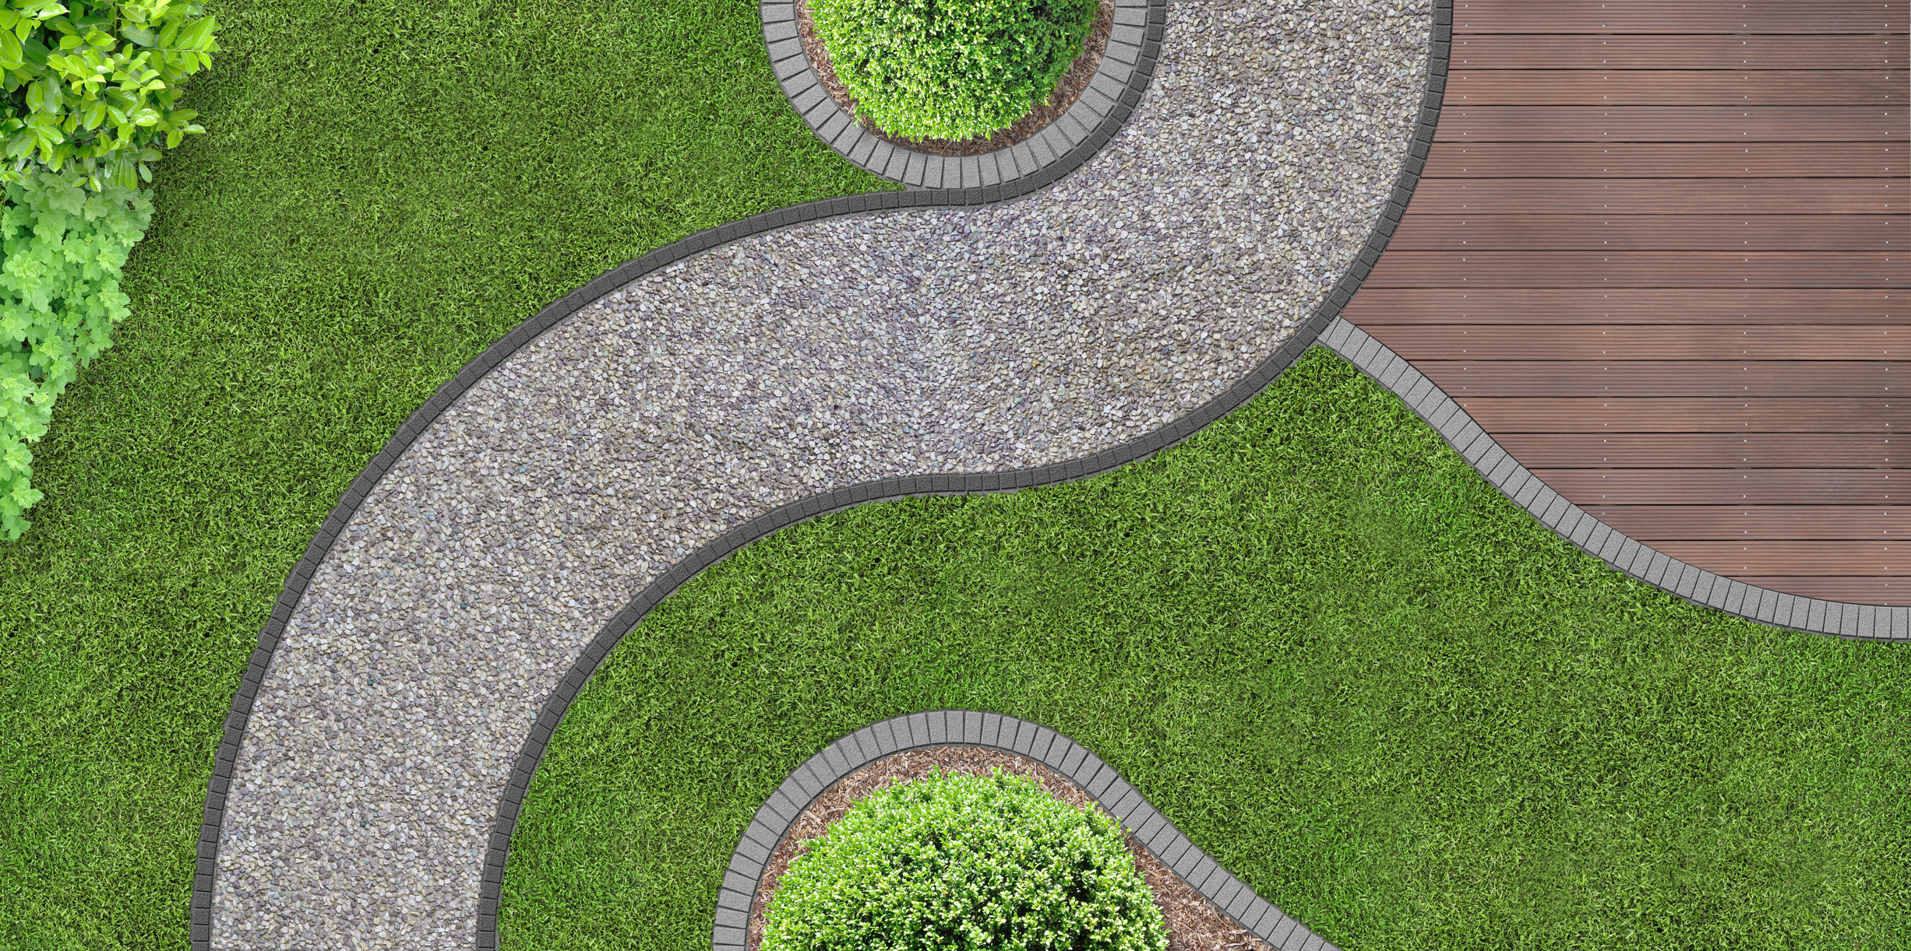
Task 1: Design your garden
Decide what your garden will look like, search for images to help. Don’t make it too complex and stick to geometric shapes to make the next bit easy.
Avoid curves, they make calculation difficult
Geometric designs with straight lines are what we want.

Slide 3
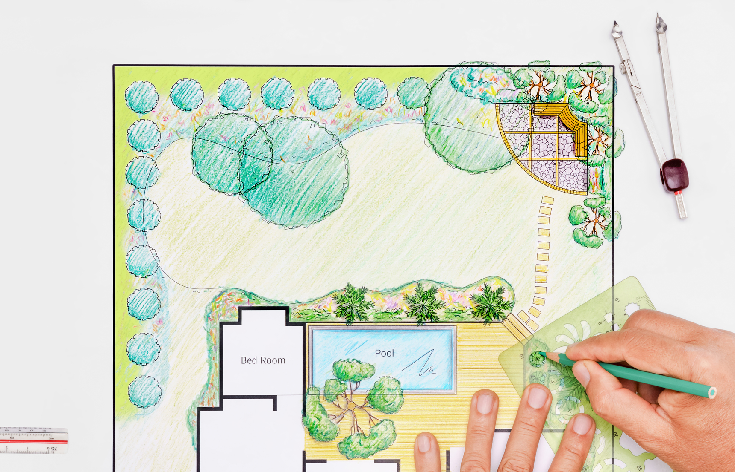
Task 2: Make a scale drawing pf your garden
Draw a plan of your garden
Use letters and a key to identify different bits
It doesn’t have to be this complicated.
You are going to work out the area of different bits, so make life easy for yourself
Make your diagram fit on an A3 sheet.
It needs to be 80 – 120m²
Think of sizes your garden can be.
Make it a rectangle!
8m x 10m makes 80m²
5m x 20m makes 80m²

Slide 4
Start with the outline, you will need a scale
My garden is going to be 5m x 20m = 100m²
To make this fit, 2cm on the paper = 1m in reality
Now add your design, you may find it easier to use squared paper, to get your lines straight
2cm = 1m
20m = 2 x 20 = 40cm
2cm = 1m
5m = 2 x 5 = 10cm

Slide 5
Here’s an example of what to aim for
A
E
A = flower Bed
B = gravel Path
C = Grass
E = Tree
C
D
C
A
C
E

Slide 6
Task 3: Calculate the cost
We are going to just focus on the big costs and not worry about lots of individual plants.
A
E
C
Look at:
Grass
Path
Trees
You may have sheds and other things to add the list
D
C
A
C
E

Slide 7
A
Let’s look at this patch of grass as an example.
This is going to be sown with grass seed
E
C
1m
You will need to look up costs of the materials
D
15m
C
A
C
E
This covers 100m²
We need 1 x 15 = 15m²
Cost = £2 x (15 ÷ 100) = 0.3 = 30p

Slide 8
Example: grass seed
Low mow lawn seed
£11
Coverage 60m²
This covers 60m²
We need 1 × 15 = 15m²
Cost = £11 × (15 ÷ 60) = £2.75
Now look at the other materials you will need for your garden.
You might need to calculate volume for gravel in a path.

