Slide 1
My independence
Learner profile questionnaire
Which course suits your learners best?
Start ➔

Slide 2
The PfA course my learners are taking now is…
New Horizons
Transition Challenge
Towards Independence
Workright
None

Slide 3
My learners have…
E
LDD (learning difficulties and disabilities)
MLD (moderate learning difficulties)
SLD (severe learning difficulties)
PMLD (profound and multiple learning difficulties

Slide 4
My learners have…
T
LDD (learning difficulties and disabilities)
MLD (moderate learning difficulties)
SLD (severe learning difficulties)
PMLD (profound and multiple learning difficulties

Slide 5
My learners have…
R
LDD (learning difficulties and disabilities)
MLD (moderate learning difficulties)
SLD (severe learning difficulties)
PMLD (profound and multiple learning difficulties

Slide 6
My learners have…
S
LDD (learning difficulties and disabilities)
MLD (moderate learning difficulties)
SLD (severe learning difficulties)
PMLD (profound and multiple learning difficulties

Slide 7
My learners are aged…
E
11-14
14-16
14+
Any age

Slide 8
My learners are aged…
T
11-14
14-16
14+
Any age

Slide 9
My learners are aged…
R
11-14
14-16
14+
Any age

Slide 10
My learners are aged…
S
11-14
14-16
14+
Any age

Slide 11
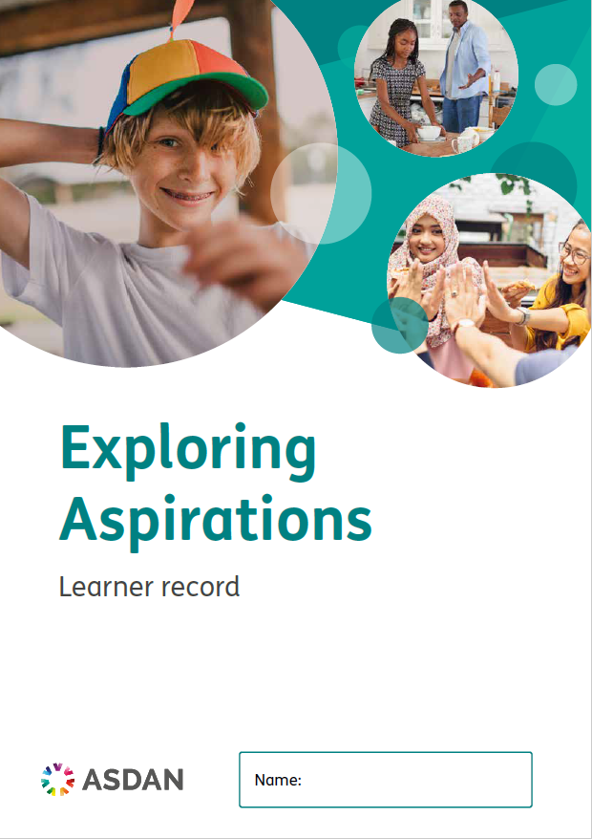
E
ASDAN recommends Exploring Aspirations
Suitable for learners aged 11–14 with SLD (severe learning difficulties) or MLD (moderate learning difficulties).
The course curriculum supports their next stage in education through PSHE, citizenship and employability skills.
Retry ⬅

Slide 12
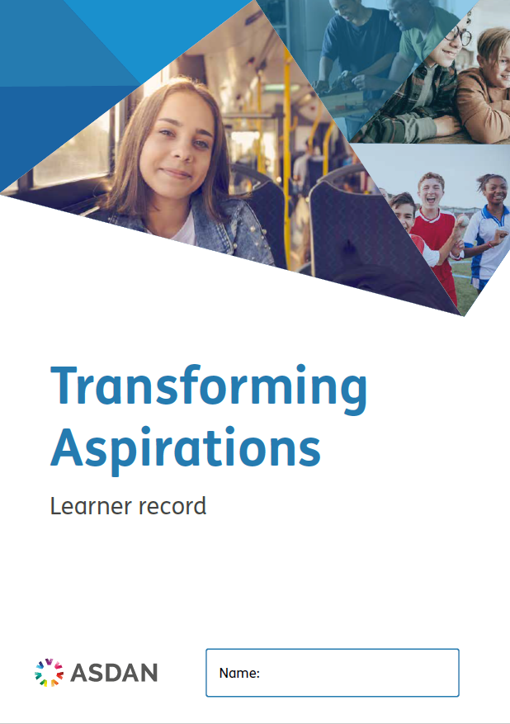
T
ASDAN recommends Transforming Aspirations
Suitable for learners aged 14–16 with SLD (severe learning difficulties) or
MLD (moderate learning difficulties).
The course curriculum supports coverage of National Curriculum compulsory subjects.
Retry ⬅

Slide 13
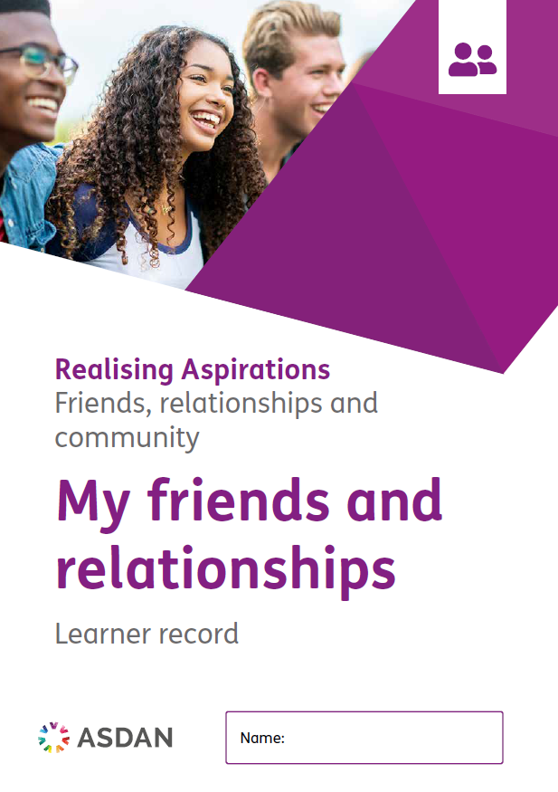
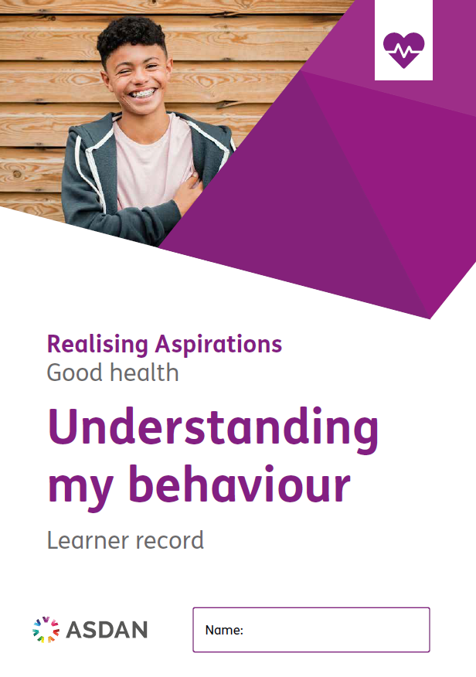
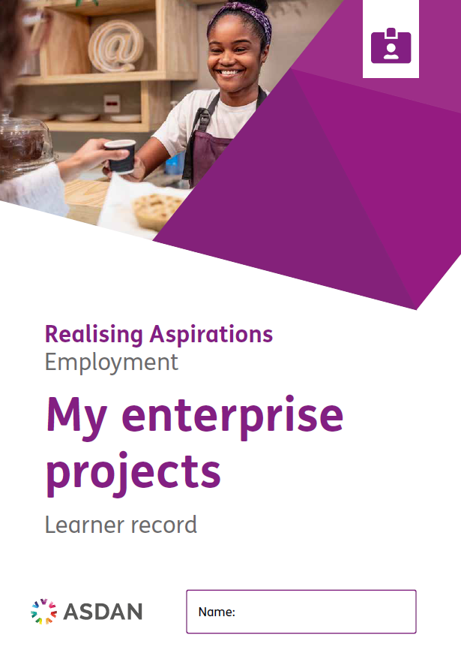
R
ASDAN recommends Realising Aspirations
Suitable for learners aged 14+ with SLD (severe learning difficulties), MLD (moderate learning difficulties) or LDD (learning difficulties and disabilities).
The course curriculum supports taking steps towards independence and planning for the future.
Retry ⬅

Slide 14
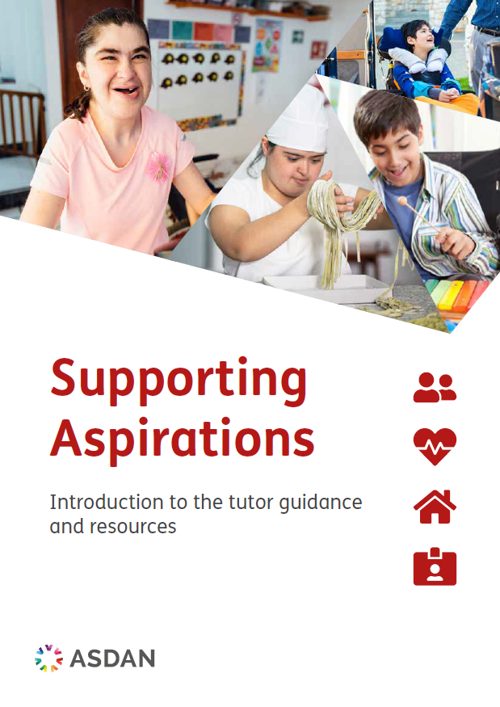
S
ASDAN recommends Supporting Aspirations
Suitable for learners of any age with PMLD (profound and multiple learning difficulties).
The course curriculum supports taking steps towards independence and planning for the future.
Retry ⬅

